Slide 1
2ECOE76 MATLAB for Engineers Lecture 1
Prepared by
-Twinkle Bhavsar

Slide 2

Outline
Why MATLAB?
What is MATLAB?
MATLAB History
MATLAB Environment
Various Toolboxes
Basic commands
Using MATLAB as a Calculator

Slide 3
Why MATLAB?

Slide 4
To be confident about the design model or the new theoretical concept actually makes the sense
Easy to work with Linear Algebra
Getting involved in science
Exploring research with MATLAB
Walking through a simulation
Image Processing
Embracing programming using computer science

Slide 5


What is MATLAB?

Slide 6
Stands for MATrix LABoratory
The programming language is exceptionally straightforward and Interactive whose basic data element is an array that does not require dimensioning.
Scientific programming environment
Great visualisation capabilities
Loads of built-in functions
Easy to learn and simple to use

Slide 7

MATLAB History
In the 1970‘ s, Cleve Moler “Professor of Math & Computer Science, Chief Author of MatLab and one of the Founders of Mathworks.Inc” participated in developing (EISPACK) and (LINPACK). Those were collection of Fortran subroutines for solving linear equations and Eigen value problems.
Later, when teaching courses in mathematics, Moler wanted his students to be able to use LINPACK and EISPACK without requiring knowledge of Fortran, so he developed the first MATLAB in 1977 as an interactive system to access LINPACK and EISPACK.

Slide 8



The first Matlab was written in 2000 lines of Fortran, with Matrices as the only data type, 80 functions, no .m files and no toolboxes.
Jack Little, one of Moler's students saw Matlab potentials in Control systems & Signal Processing.
They founded together Mathworks, Inc. in 1980

Slide 9

Mathworks is now responsible for development, sale, and support for MATLAB
MATLAB was rewritten in C with more functionality (such as plotting routines), and now it contains more than 80,000 functions.

Slide 10
MATLAB Environment

Slide 11
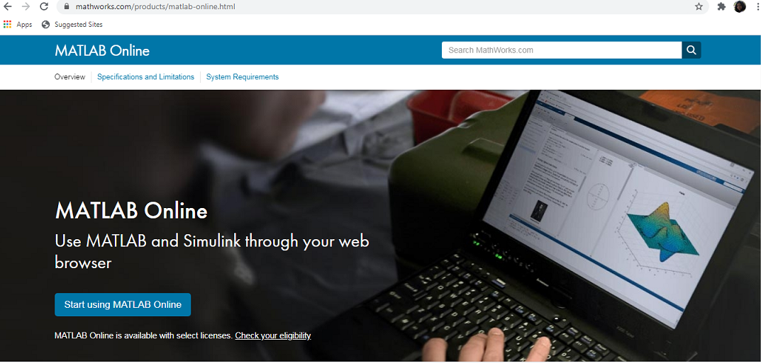
To start online MATLAB :
Click

Slide 12
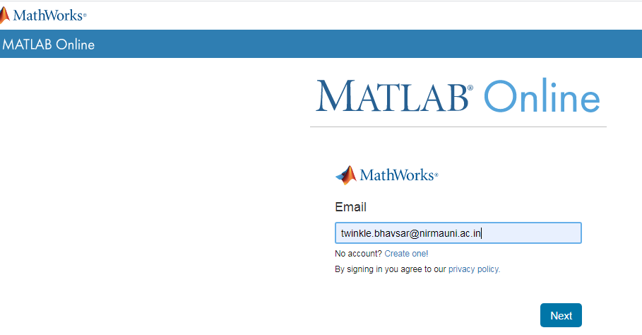
Enter e-mail address and password

Slide 13
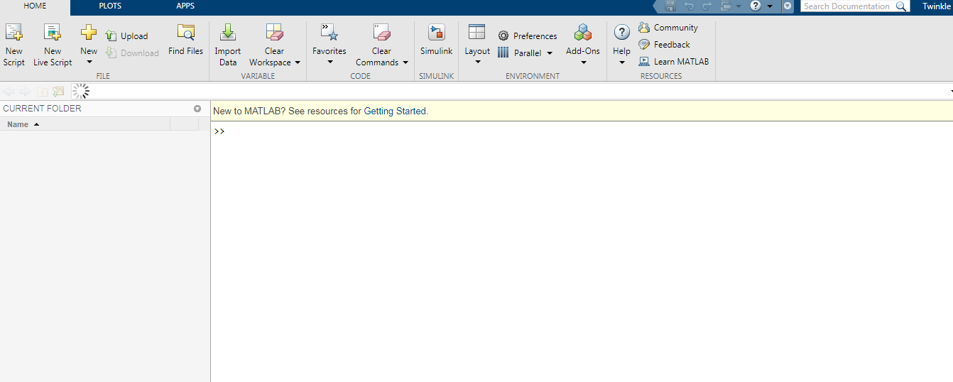
You will see the following screen

Slide 14
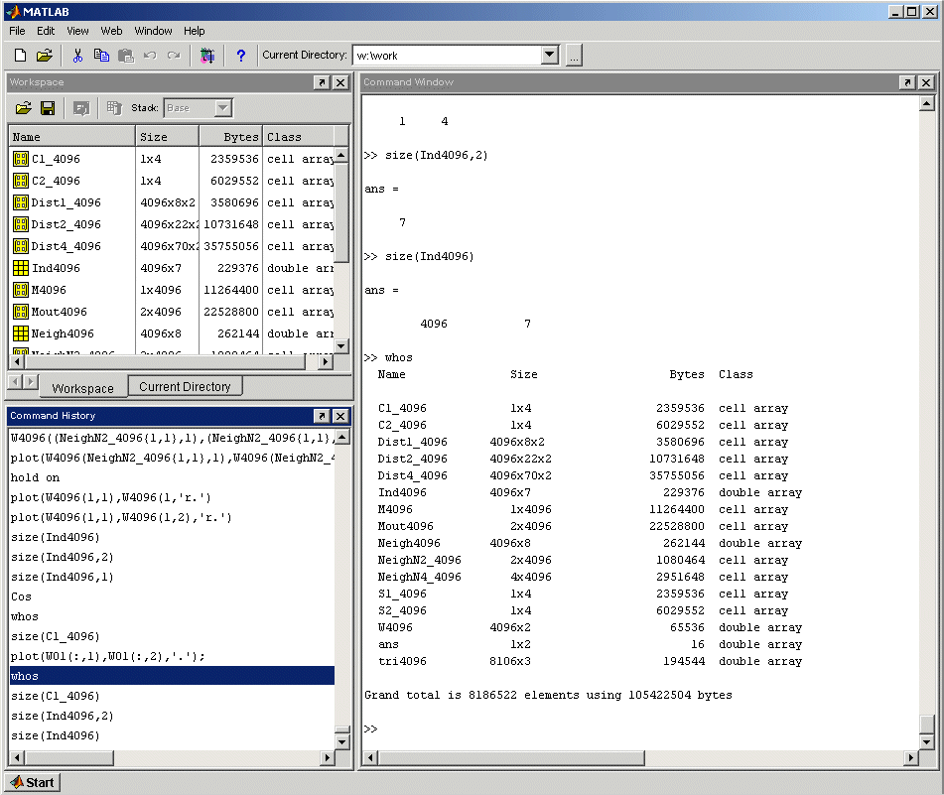








MATLAB Desktop
Command Window
Workspace / Current Directory
Command History

Slide 15
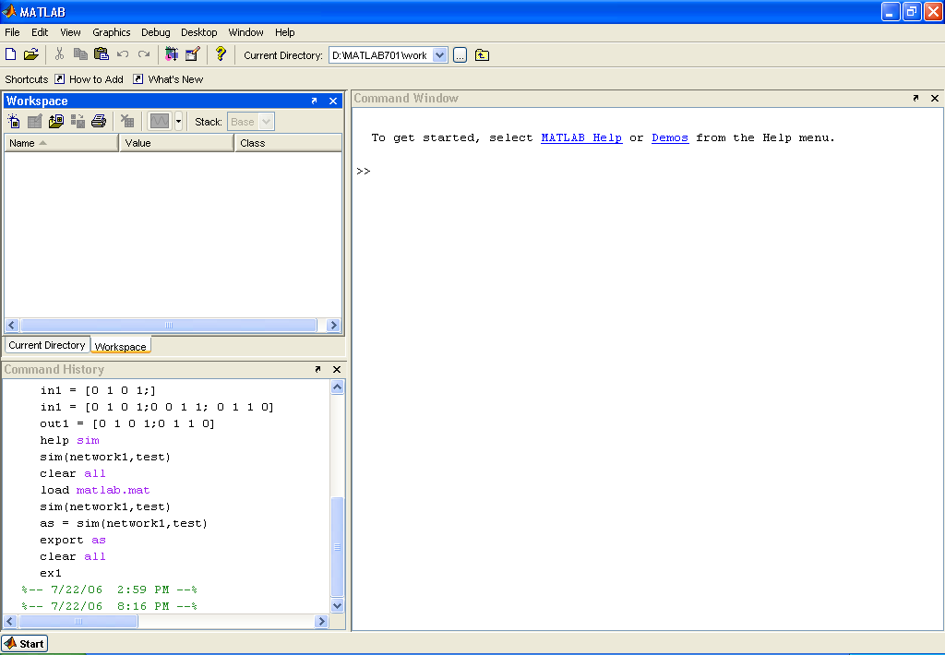

prompt

Slide 16
To start offline MATLAB:
Type “MATLAB” in the start menu and click on it

Slide 17
Command oriented somewhat like UNIX.
A prompt appears on the screen and a MATLAB statement can be entered.
When the <ENTER> key is pressed, the statement is executed, and another prompt appears.
If a statement is terminated with a semicolon ( ; ), no results will be displayed. Otherwise results will appear before the next prompt.
Notes:
Instructor notes:
Matlab is part language and part environment. You can enter Matlab commands directly into the command window and Matlab will execute them as soon as the <ENTER> key is pressed. You can also write programs in Matlab which are a collection of Matlab commands and run those programs in the Matlab environment. This is much like writing a program in C or C++ and running it in the UNIX environment or the Visual Studio environment, for example.
One of the functions of the semicolon in Matlab, depending on the immediate context, is that of output suppression operator. By placing a semicolon at the end of a line, the output generated by that line will not be displayed in the command window. The line will still be executed, but the results will not be displayed. This is particularly useful when producing large arrays of data that you don’t want displayed in the command window because of their size.

Slide 18
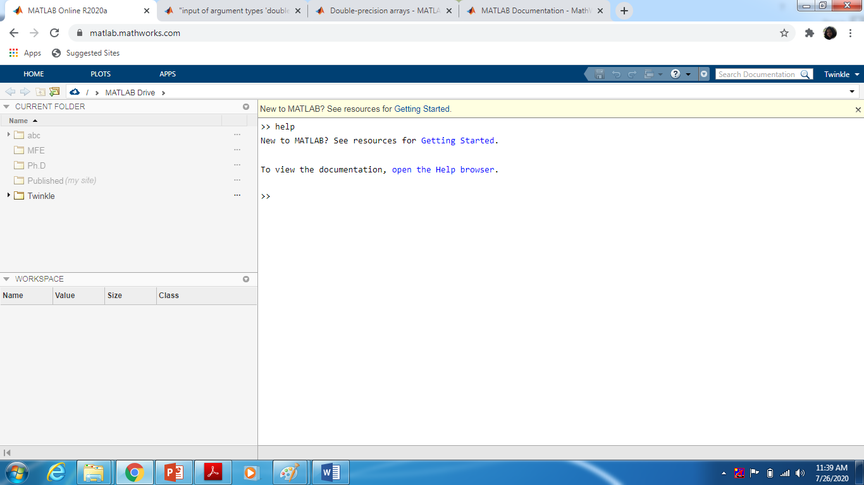
Getting Help

Slide 19


Getting Help and Looking Up Functions
To get help on a function type “help function_name”, e.g., “help plot”.
To find a topic, type “lookfor topic”, e.g., “lookfor matrix”

Slide 20
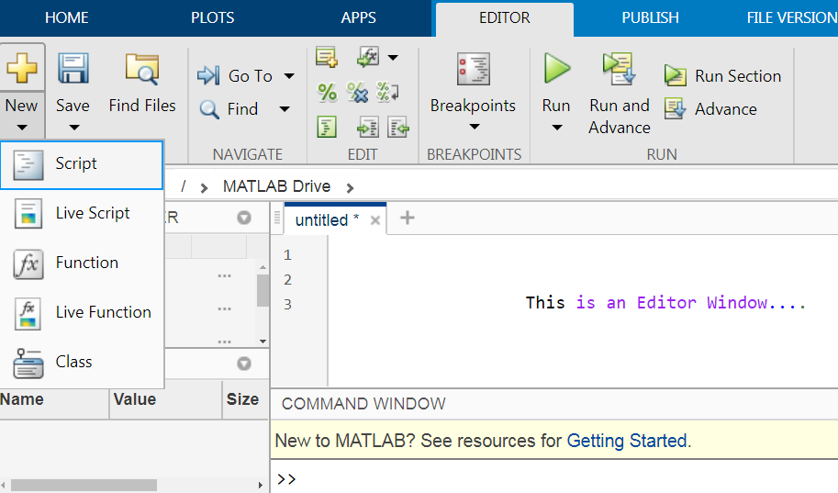
Scripts
MATLAB editor
Use scripts to execute a series of MATLAB commands
Press to create new m-file in the matlab editor

Slide 21
Scripts
Are used to store variables and matrices in the MATLAB workspace (memory).
Can be executed from the MATLAB command line by typing the (case sensitive!) filename of the script file.
>> myscript
Can be opened in the editor by the following
>> open myscript
always have filenames ending with “.m”.

Slide 22
Various Toolboxes

Slide 23
Toolboxes are comprehensive collections of MATLAB functions (M-files) that extend the MATLAB environment to solve particular classes of problems.
Areas in which toolboxes are available include signal processing, control systems, neural networks, communications, wavelets, Data Acquisition, simulation, and many others.

Slide 24
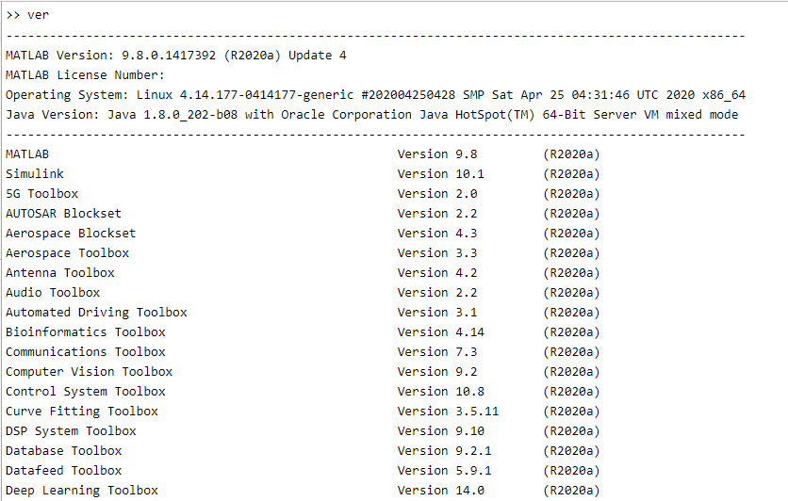

Slide 25
Basic commands

Slide 26
Command | Description
% | used to denote a comment
; | suppresses display of value (when placed at end of a statement). However, echoing the results of calculations makes a great quick-and-dirty debugging tool. If you are not certain what the results of a specific assignment statement are, just leave off the semicolon from that statement, and the results will be displayed in the Command Window as the statement is executed.
... | continues the statement on next line
inf | infinity
NaN | not-a number, e.g., 0/0
who, whos | current workspace varibles
clear all | clear workspace variables
close all | close all figures
clc | clear screen
clf | clear figure

Slide 27
Using MATLAB as a Calculator
(See 2.8 of Chapman Book)

Slide 28
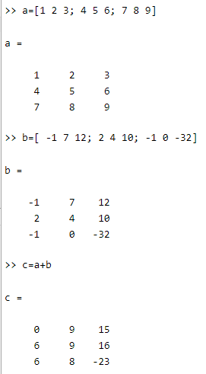
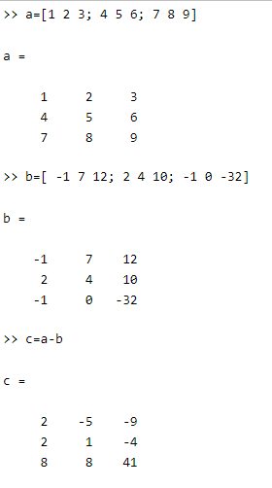

Array Addition
Array Subtraction

Slide 29
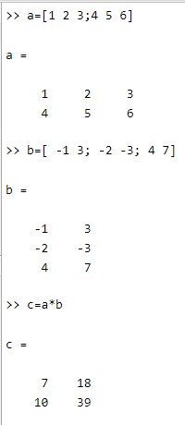
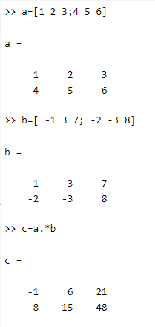
Element by Element Array Multiplication
Array Multiplication

Slide 30
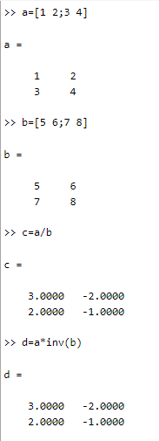
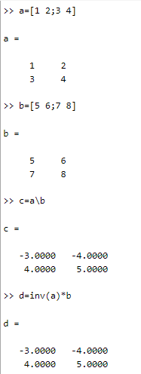
Slash or right
matrix divide
Backslash or left
matrix divide

Slide 31
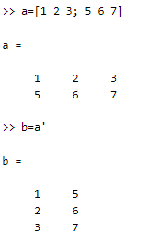
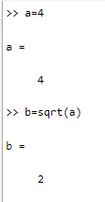
Using transpose operator
Square root of a number

